Slide 1
Woche 14: Cultural Presentation
Kyle Lund

Slide 2
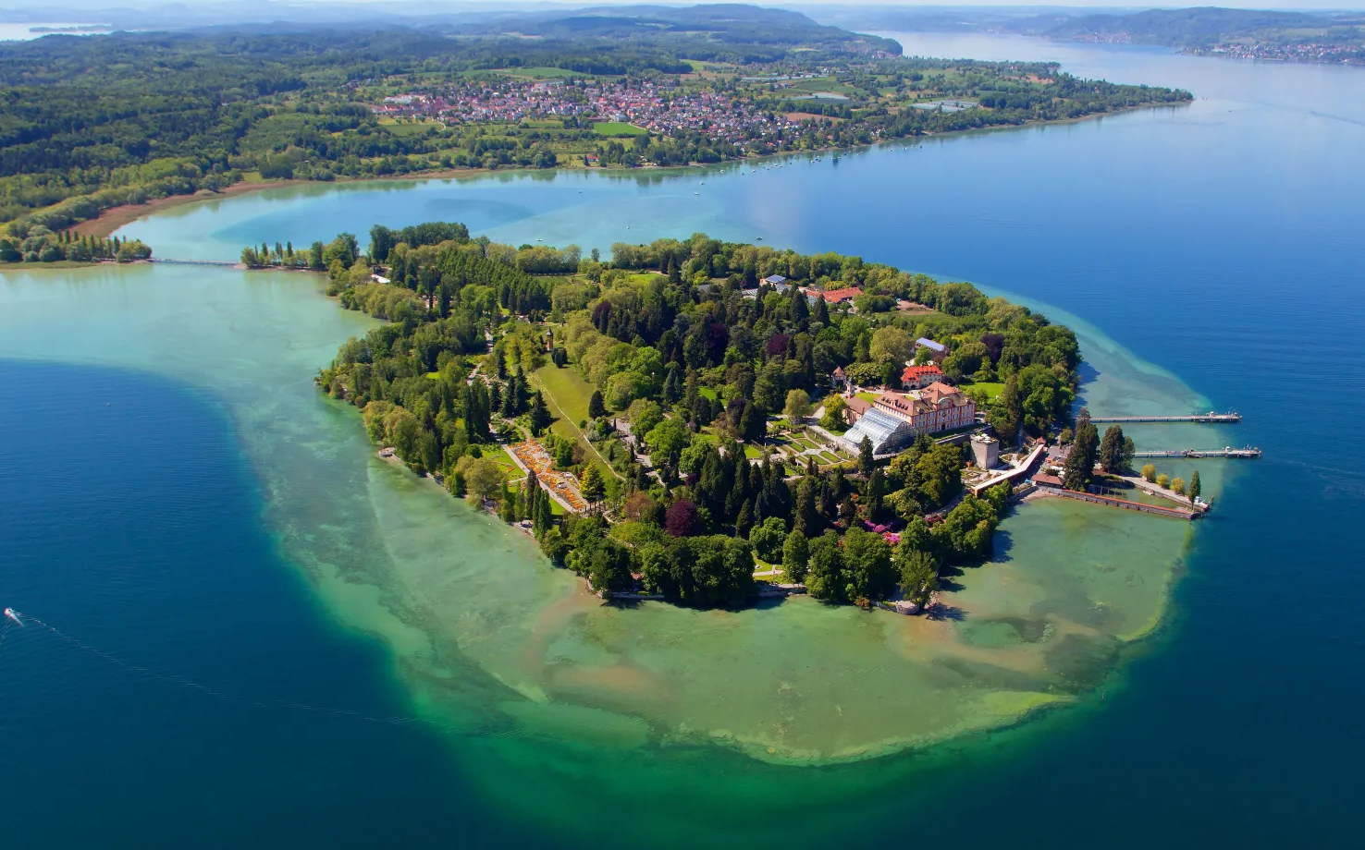
Geography
45 hectares
Mild climate
Suited for large-scale horticulture
https://www.mainau.de/en/home
https://www.mainau.de/en/home
Notes:
Mainau Island sits in Lake Constance in southern Germany, close to the borders with Switzerland and Austria. It covers about 45 hectares, a little under one square kilometer. The island is only about a kilometer long, so it is easy to walk from end to end.
Its position in Lake Constance gives it a mild climate. The surrounding water keeps temperatures more stable than on the mainland. Winters tend to be softer, and summers stay moderate. This is important because it allows plants that normally prefer warmer regions to survive and grow here.
The island’s terrain is simple: gentle slopes, a central rise where the palace and church stand, and low shoreline areas that hold many of the gardens. From its higher points, visitors can look across Lake Constance toward the hills and, on clear days, the Alps on the horizon. Much of the island is developed as garden space, but the land beneath it is natural glacial terrain shaped by the same forces that formed the lake.
Overall, Mainau’s geography is a blend of small size, lake-moderated climate which makes its environment unusually suitable for large-scale horticulture.

Slide 3
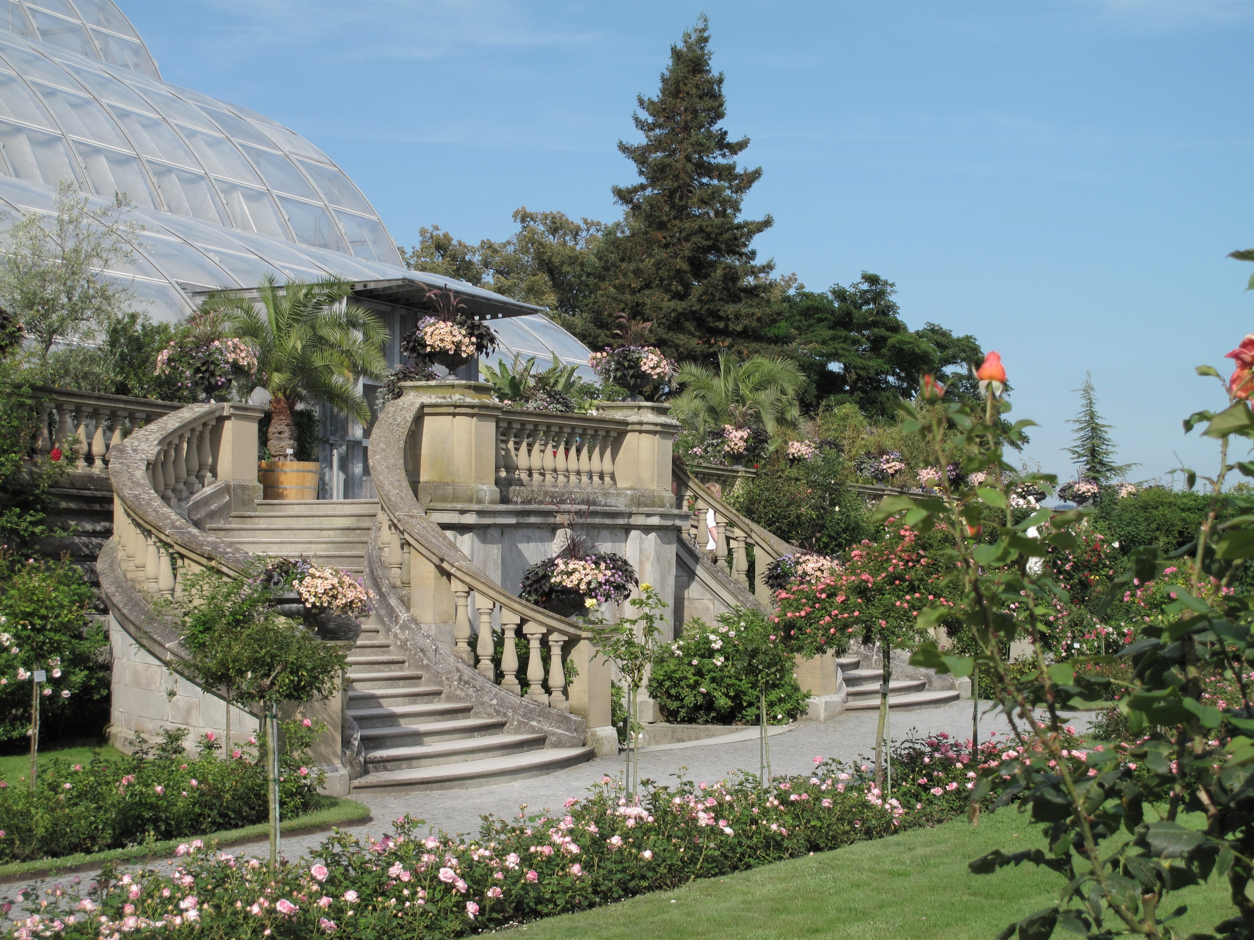
Flora
Flowering Island
Arboretum housing 500 different tree species
Seasonal blooms
Rose gardens
https://facts.net/world/landmarks/25-facts-about-mainau/
https://www.mainau.de/de/sehenswuerdigkeiten/palmenhaus
Notes:
Mainau often bears the title “Flowering Island” — and for good reason. Its grounds hold an arboretum originally created in the mid-19th century, which is now home to around 500 different tree species. This includes some exotic varities; such as giant sequoias imported from California, which were planted in 1864, as well as dawn redwoods brought from China in the 20th century — specimens counted among the oldest of their kind in Germany.
But the arboretum is only the backbone. Each season has its own distinct color and scent. In spring, carpets of tulips, daffodils, hyacinths and primroses bloom along winding paths.
By late spring into early summer, over 200 varieties of rhododendrons and azaleas burst into bloom, which paint the various slopes and garden with a variety of unique colors.
Mid-summer brings the island’s famed rose gardens: Mainau hosts roughly 30,000 rose bushes of around 1,200 varieties, arranged in terraces around fountains and classical sculptures throughout the area.
As the year turns toward autumn, Mainau’s floral splendour shifts again: 20,000 dahlias of many varieties blaze in reds, oranges, pinks.
Beyond seasonal flowers, subtropical and even Mediterranean-style plants such as palms, citrus trees, agaves, bougainvillea flourish die to the lake’s tempered climate.
The result of all this an arboreal tapestry, structured formal gardens, and a seasonal bloom that is different every time you visit, which transforms this small island into a year-round horticultural wonder.

Slide 4
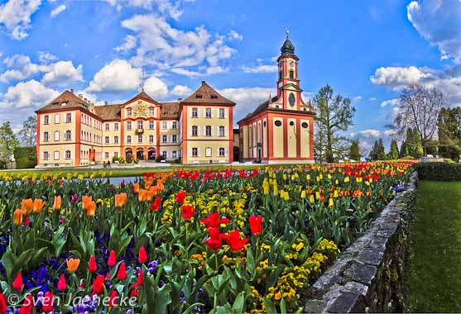
History
Teutonic Order
Church of St. Mary
Grand Duke Frederick I
Mainau Foundation
https://www.mainau.de/de/sehenswuerdigkeiten/schlosskirche-st-marien
https://www.konstanz-magazin.de/Fotos/schlosstulpen.jpg
Notes:
Mainau’s recorded history stretches back to the Middle Ages. In the 13th century, the island came under the control of the Teutonic Order, which was a military and religious order active throughout Central Europe. During their period of ownership, they built both a castle and a church on the island. The church which was dedicated to St. Mary remains one of the island’s central historical landmarks and is still used for religious services, concerts, and other small ceremonies.
In 1853, Grand Duke Frederick I of Baden purchased Mainau. He was the one who made Mainau what it is today by reshaping the island into a botanical estate, bringing in exotic tree species and establishing many of the garden structures that still exist. In the early 20th century, the island passed to Count Lennart Bernadotte, a member of Sweden’s royal family. He expanded public access, developed new garden areas, andfurther promoted Mainau as a cultural and botanical site. To preserve the island’s long-term future, he and his family established the Mainau Foundation in 1974. The foundation continues to manage the palace, the church, and the extensive gardens.

Slide 5
Sources
Insel Mainau. “Insel Mainau.” Insel Mainau, www.mainau.de/en/home. Accessed 26 Nov. 2025.
“Mainau.” Konstanz Magazin, www.konstanz-magazin.de. Accessed 26 Nov. 2025.
Schutz, Sharleen. “25 Facts About Mainau.” Facts.net, 20 Mar. 2025, facts.net/world/landmarks/25-facts-about-mainau. Accessed 26 Nov. 2025.

